Slide 1
ISMS:Leading InfoSec Governance Framework
ISO27001:2013 (ISMS)
Specifies the requirements for establishing, implementing, maintaining and continually improving an information security management system
Ten short clauses
Long annex

Slide 2
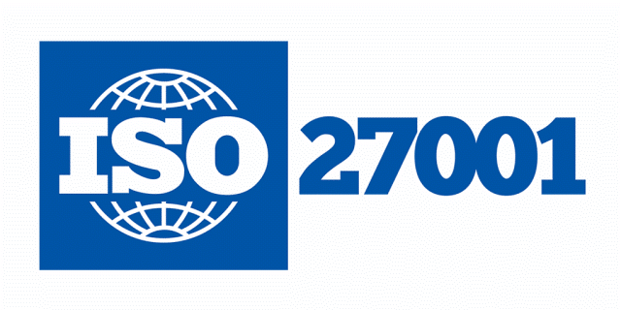
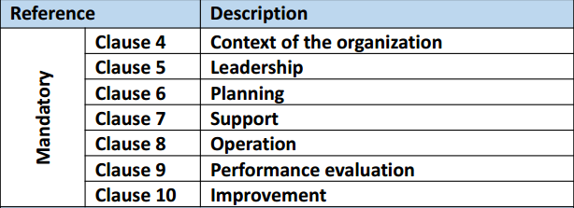
ISMS:Leading InfoSec Governance Framework
ISO27001:2013 MANDATORY CLAUSES
https://chapters.theiia.org/bermuda/Events/ChapterDocuments/Information%20Security%20Management%20System%20%28ISMS%29%20Overview.pdf

Slide 3
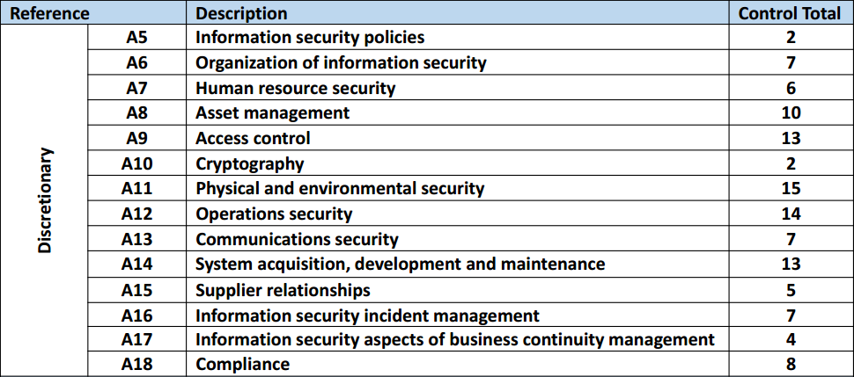
ISMS:Leading InfoSec Governance Framework
ISO27001:2013 DISCRETIONARY CONTROLS
TOTAL: 113
https://chapters.theiia.org/bermuda/Events/ChapterDocuments/Information%20Security%20Management%20System%20%28ISMS%29%20Overview.pdf

Slide 4
ISMS:Leading InfoSec Governance Framework
Merits of ISO27001:2013 (ISMS):
Exceptional framework with comprehensive coverage of mandatory requirements (clauses 4-10) and discretionary controls (annex)

Slide 5
ISMS:Leading InfoSec Governance Framework
Merits of ISO27001:2013 (ISMS):
Highly beneficial as a framework for security program
Covers all domain areas
Provides a structure and organized sequence for security controls

Slide 6
ISMS:Leading InfoSec Governance Framework
Merits of ISO27001:2013 (ISMS):
Complements security transformation model as serves as a reference and guideline for activities and controls

Slide 7
ISMS:Leading InfoSec Governance Framework
De-merits of ISO27001:2013 (ISMS):
Very broad
Generic framework – leaves it to organization how to implement the measures and controls
Not suited for orgs that are new to security program

Slide 8
ISMS:Leading InfoSec Governance Framework
How to best use advantages of ISO27001:2013 (ISMS):
Implement security transformational model
Cap off security transformation project with ISO27001:2013 (ISMS) certification

Slide 9
ISMS:Leading InfoSec Governance Framework
How to best use advantages of ISO27001:2013 (ISMS):
ISMS as a complementary reference and checklist rather than main framework

